Slide 1
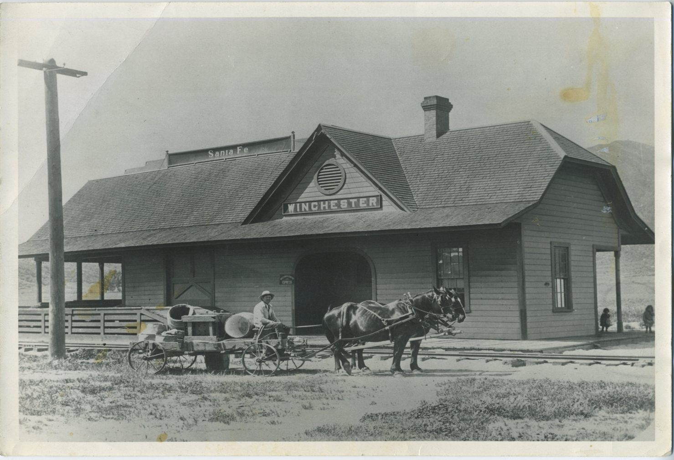
Land Use Study for the Community of Winchester July 9, 2012

Slide 2
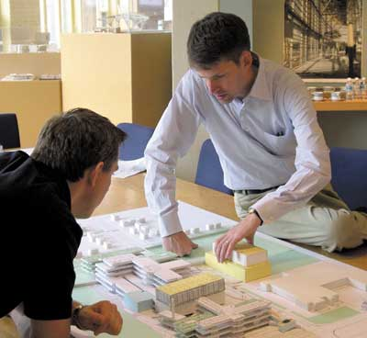
WELCOME
Overview of the Draft Land Use Study’s Goals, Objectives and Policies

Slide 3
Goals, Objectives and Policies for:
Land Use (Downtown Core and overall Community of Winchester)
Community Design
Circulation
Multi-Purpose Open Space/Recreation
Sustainability

Slide 4
Land Use
Downtown Core Land Use Goal:
Create a unique and integrated mix of residential, office, commercial, retail, industrial, civic and recreational land uses in the Downtown Core that generate daily activity in the daytime and evenings to create a lively and dynamic environment.

Slide 5
Downtown Core Land Use Policies :
Prepare a Specific Plan
Smart Growth, New Urbanism, Transit-Oriented Development and Sustainable Design Principles
Mixed Use Zoning
Compact, TOD infrastructure—less auto dependency

Slide 6
Downtown Core Land Use Policies (cont.)
Transit station in Downtown
Appropriate uses in Downtown and adequate Open Space
Maintain existing alleys
Highway 79 re-alignment—re-analyze once final alignment is approved

Slide 7
Winchester Land Use Goal (outside of Downtown Core)
Ensure a balance of residential, office, commercial, retail, industrial, recreational land uses and public facilities uses that will support the successful, long term build out of the community of Winchester.

Slide 8
Winchester Land Use Policies (outside of Downtown Core)
Balance of land uses
Public utilities in place prior to development
Develop standards for legal, non-conforming uses as a result of Land Use Study

Slide 9
Winchester Land Use Policies (cont.) (outside of Downtown Core)
Develop communities to be connected through multi-modal transportation systems
Regional commercial and retail near freeways or major arterials
Residential near community and regional centers & employment hubs—reduce commute times

Slide 10
Community Design Goal
Ensure the community develops so that it creates a clear sense of identity and place that is unique to the community of Winchester.

Slide 11
Community Design Policies
Development Standards and Design Guidelines
Distinct image for Winchester
Pedestrian oriented Downtown
Design that is walkable, livable, human scale
Public gathering spaces (cultural/festival/ farmer’s market or concerts)

Slide 12
Community Design Policies (cont.)
Landscape streetscape and increase pedestrian travel
Sign Standards appropriate to Winchester and pedestrian oriented
Entry Monumentation:
Clear, identifiable entry
Strong sense of place
Reflect design theme of Downtown

Slide 13
Circulation Goal
Create a circulation system that can accommodate the proposed Land Use Plan of the Winchester Land Use Study that complies with the County wide target Levels of Service that facilitate the movement of vehicles, but places a strong emphasis on safe and efficient pedestrian pathways and alternative modes of travel.

Slide 14
Circulation Policies
Area effected by Hwy. 79 re-alignment to be re-analyzed once final alignment is approved
Reduce street width and speed along Simpson Rd.
Transit station in Downtown Core
Implement Multi-modal and TOD concepts throughout Winchester

Slide 15
Circulation Policies (cont.)
Enhance and protect alley network system
Adequate parking—don’t compromise walkable of Downtown
Plan for off-street parking (i.e. structures, lots,
park-n-rides)

Slide 16
Circulation Policies (cont.)
Implement round-a-bouts and “choke” down street widths in Downtown Core
Ensure streets consider pedestrian and bike lanes and/or routes
Roads or transit centers to minimize noise impacts to sensitive receptors

Slide 17
Multi-Purpose Open Space and Recreation Goal
Create opportunities for additional open space and recreational opportunities to serve a variety of needs and diversity of users within the Community of Winchester.

Slide 18
Multi-Purpose Open Space and Recreation Policies
Public gathering, civic and cultural events in Downtown Core
Appropriate distribution of amenities in various land uses
Provide open space in developments (buffers/relief)
Pedestrian, equestrian and bicycle street and trail network system—connectivity

Slide 19
Multi-Purpose Open Space and Recreation Policies (cont.)
Provide two regional park facilities
Enhanced opportunities within Salt Creek (including bridge crossing)
Park and Recreational use of Double Butte
Consider a separate trails assessment

Slide 20
Sustainability Goal
Encourage land use planning and development to be efficient in the use of non-renewable resources and improved air quality to reduce impacts on the surrounding environment.

Slide 21
Sustainability Policies
Design and construction per green building practices and green—reduce air, water and land pollution/environmental impacts
LEED certification or equivalent
Land uses near public transportation—reduce vehicle trips

Slide 22
Sustainability Policies (cont.)
Low Impact Development and BMPs
Maximize light—proper siting of building
Reduce heat island by preserving and providing shade

