Slide 1

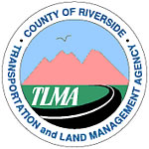
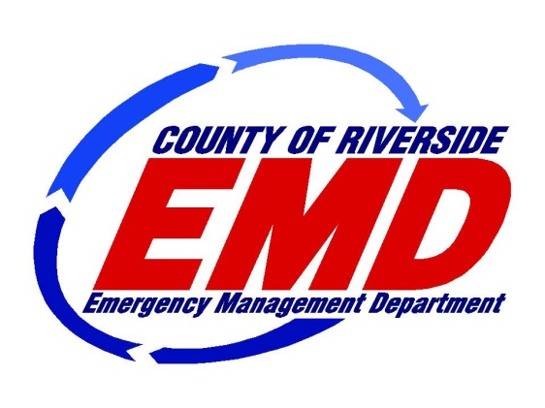
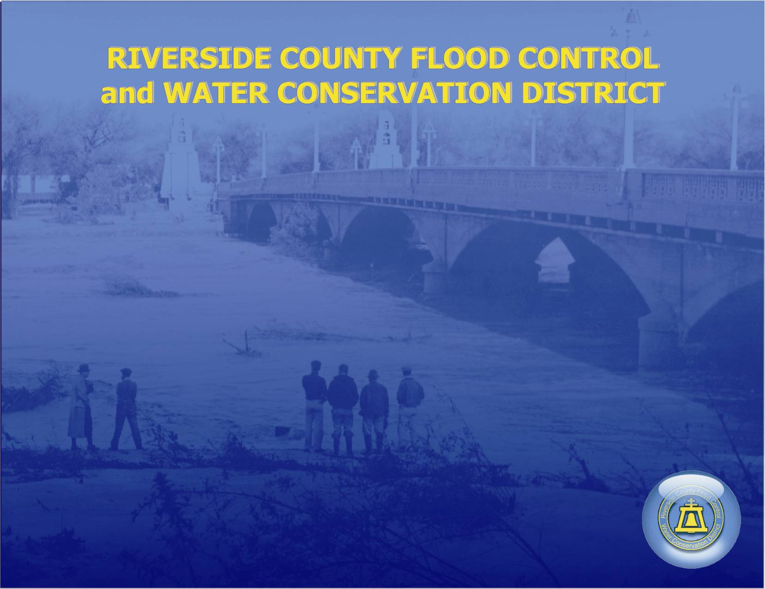

El Niño: Riverside County Prepares
Winchester/Homeland Municipal Advisory Council

Slide 2
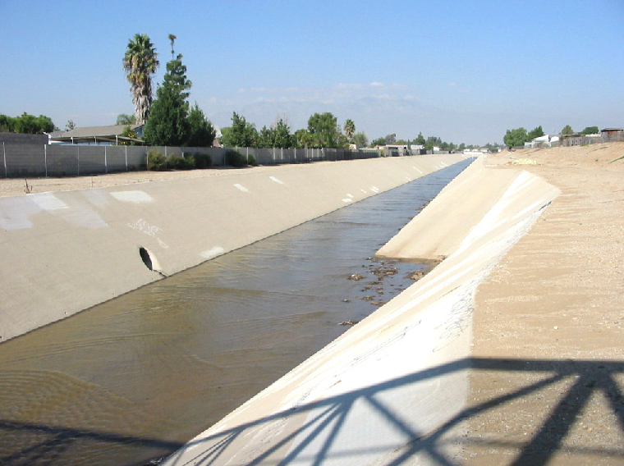
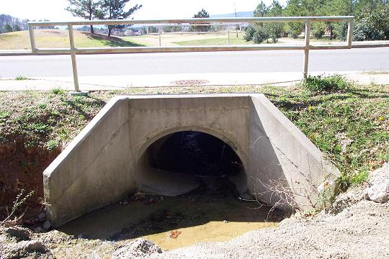
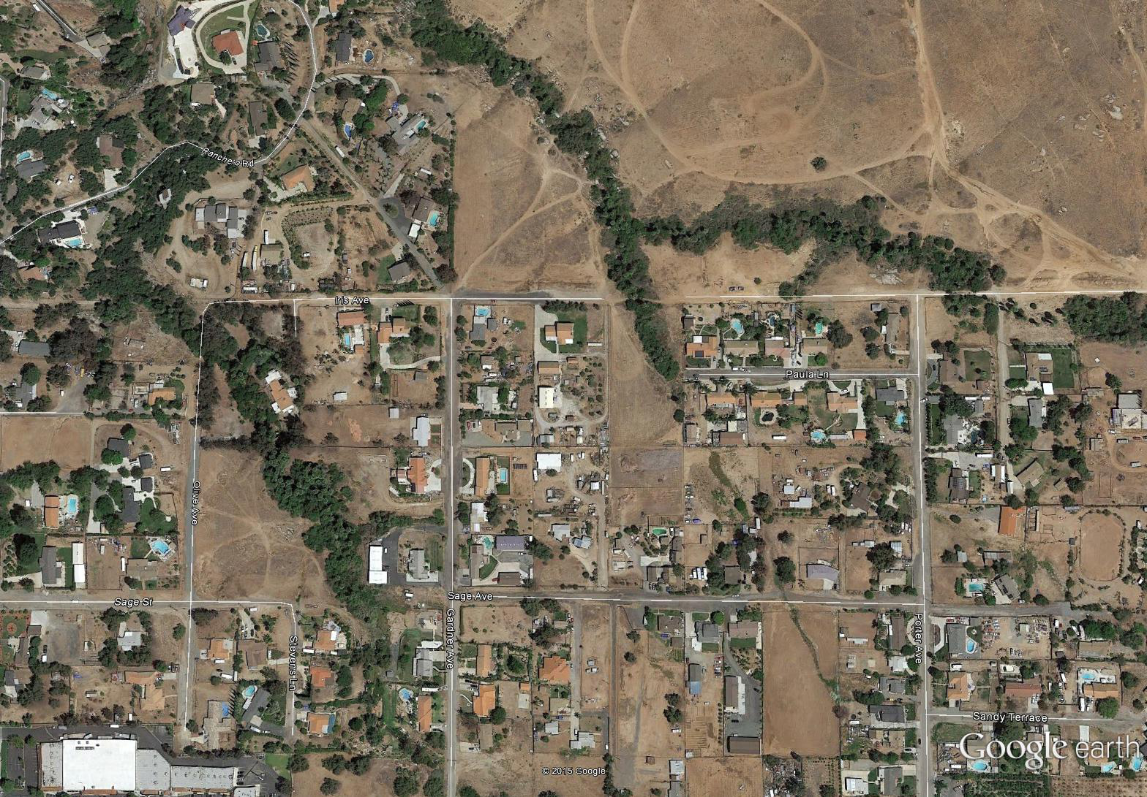
Many Responsible for Flood Management
Riverside County Flood
  Dams, levees, basins
  Regional channels and storm drains
Cities/County
  Road culverts
  Smaller storm drains (<=36”)
  Catch basins (roadside inlets)
Rural Property Owners/HOAs
  Minor drainage infrastructure
  Keep natural washes within private property free from obstruction
Notes:
Who is responsible for flood protection – We all are… FCD manage regional facilities that protect whole communities; cities and County handle interior drainage infrastruction serving tracts and roads; however most stream miles are actually in private ownership; particularly in rural areas. It is incumbent upon those property owners with stream courses to keep them clean and clear of debris so that they don’t cause flooding on their own property or on their neighbors.
So we all have a roll, and the purpose of this presentation is to talk about how we can work together to protect our communities from El Nino related storms.

Slide 3
Presentation Outline
El Nino and Flood Risk
Property Preparedness
Family Preparedness
Notes:
I will lead off with a bit of background about El Nino and the District’s presentation.
TLMA will then cover some steps you can take to protect your property from flooding;
EMD will close with a discussion about steps you can take to protect your family.

Slide 4

Notes:
So what exactly is Godzilla el nino

Slide 5
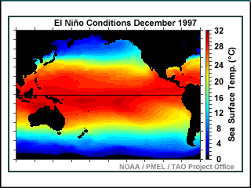
What is El Nino?
El Niño is a weather phenomenon that involves a warming of the Pacific Ocean west of Peru. The temperature increase can cause dramatic changes in weather patterns worldwide, bringing wet rains to California but drought to Indonesia and Australia.
Notes:
El nino is a name for a condition where the pacific ocean becomes warmer than normal along the equator.

Slide 6
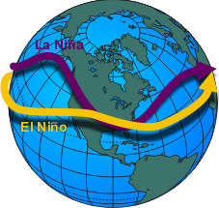
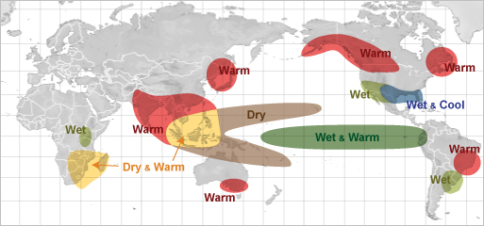
Change in Jet Stream Delivers More Rain to Southern California
L
L
L
Notes:
The warming leads to changes in the weather patterns, that ultimately causes the jet stream to dip south; typically over southern California.
The storm track tends to follow the jet stream. This is why we tend to have wetter winters during el nino.
El Nino is a global phenomenon, so it has other impacts in other places; - but for us it typically means wetter winters.

Slide 7
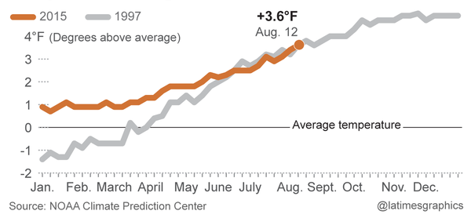
Why is this one such a big deal?
This El Niño is as strong as the record 97/98 El Niño
Strong El Niños tend to predict wet years
Notes:
Everyone is excited because the warming pattern in the pacific is very similar to the 97/98 el nino. That el nino caused over $300 million in damage in southern California; including 30 million in Riverside County.
The forecasters are predicting a similar outcome this year.

Slide 8
Historic Rainfall
Non-El Niño vs. El Niño
5 strong El Niños – 1958 (25”), 1966 (14”), 1973 (15”), 1983 (24”), 1998 (25”)
Very Strong
25”
Moderate
Avg. Annual
12”
1993
1998
2005
2011
Notes:
But we should note that El Nino is just a better predictor of wet years. It doesn’t necessarily mean record setting wet years, or wet years in excess of other years. In the last 25 years we have had 3 major wet years, one of which was an el nino. It ranked in the middle of the three. The important thing regarding el Nino is that it gives us fair warning that this winter could be very wet.
WET Years 1922 (25”), 1937 (25”), 1952 (20”), 1969 (18”), 1978 (28”), 1980 (22”)

Slide 9
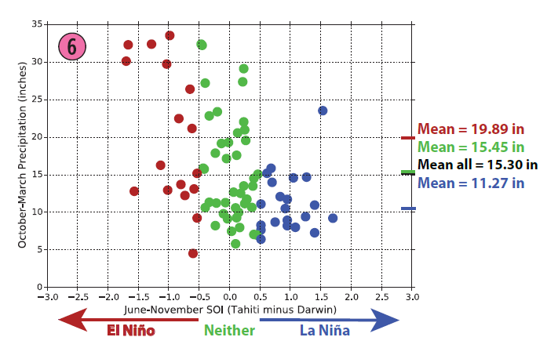
Another way to put it

Slide 10
1997-1998 Rainfall
Most rain in a day: 2”
Most rain in a month: 11”
Total Rainfall: 25”
Notes:
El nino doesn’t necessarily mean torrential flooding either. It typically means more storms – say 20 one inch rainfall events instead of 10.
El Nino also tends to extend the wet season. The wet season typically ends around march, El Nino winter rains can extend into june.
El Nino starts to cause problems when storms come back to back like they did in February 1998. Otherwise, it was just more or less wet all the time.
We should also note that Riverside has been sheltered from the worst of El Nino, for example in February 1998 we received 11” of rain. Santa Barbara received 22”.

Slide 11
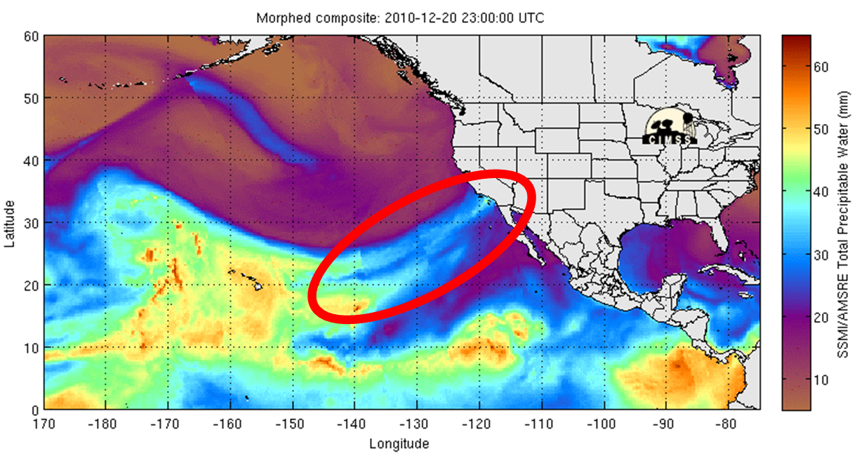
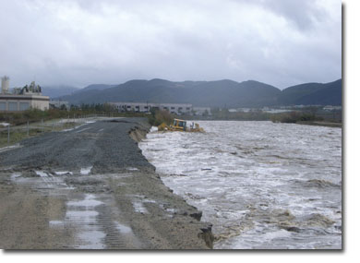
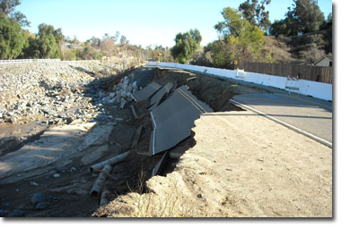
Atmospheric Rivers also a Concern
Can Produce Intense Storms
Riverside – Dec. 2010
  1-day – 3.2”
  5-day - 7.2”
Temecula – Dec. 2010
  1-day - 5”
  5-day– 12.2”
Murrieta Creek
Mockingbird Canyon Road
Notes:
There is another phenomenon called atmospheric river. Also known as pineapple express. This produces intense, flood inducing storms like the Dec 2010 storms. These can happen at any time – including el nino years.
The Dec 2010 river led to some of the most significant flooding we had seen in years. 50 year old dams spilled for the first time (Sycamore) in their history. The District is always watching for these events as well.

Slide 12
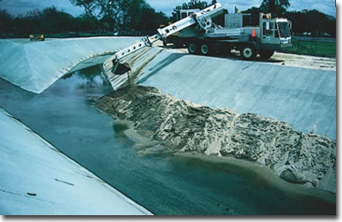
Flood Control Preparations
Complete inspection of facilities
Flood-fight training for staff
Mock-storm drills
Emergency contracts with contractors and rock and equipment suppliers
Public Outreach (Brochures, websites, presentations)
Coordinating with City/County Departments and other local, state and federal emergency management agencies.
Notes:
District is doing a lot to prepare

Slide 13
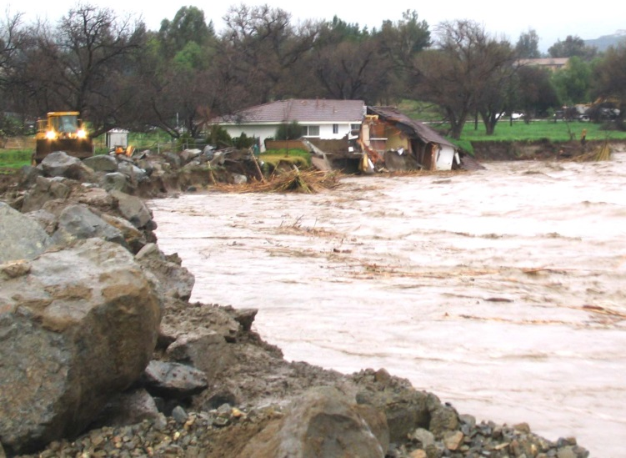
Information for Homeowners if Subject to Flooding
Standard homeowner policies do not cover flood damage!
Purchase Flood Insurance offered by the National Flood Insurance Program
(Policy takes 30 days to activate)
1-888-Call-Flood
www.floodsmart.gov
Notes:
If you think you may have flooding problems. Consider purchasing flood insurance. IF you don’t live in a floodplain, it can be less than $400 a year. Flood damage can easily exceed tens of thousands of dollars. Standard homeowners insurance does not cover flooding.

Slide 14
Community Specific Information
Blank Slide Placeholder for local flood issues/concerns
Highlights/projects
Etc.

Slide 15
Property Preparedness Tips
Notes:
I would now like to introduce XXX from TLMA

Slide 16
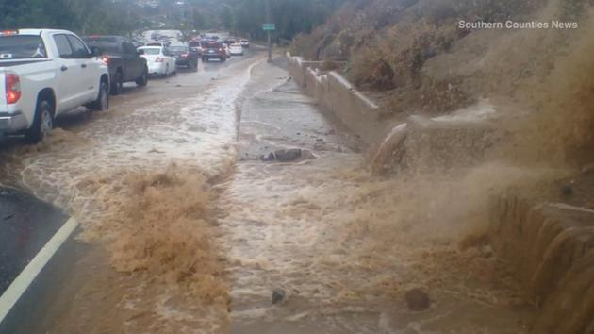
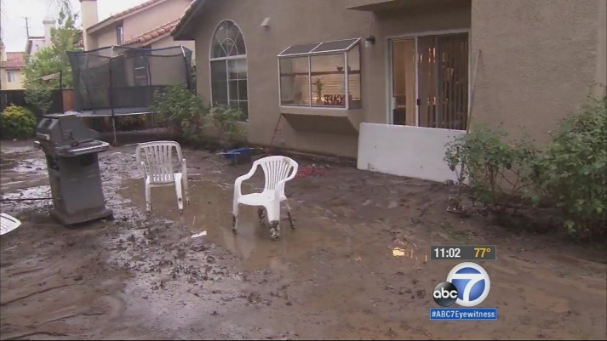
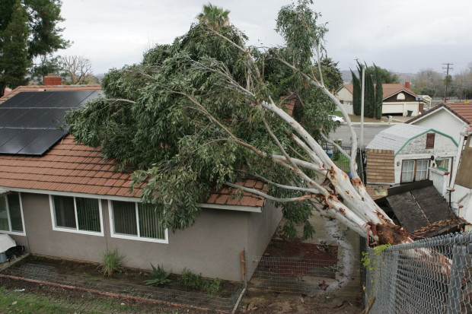
Preventable El Nino Rain Impacts:
Unprotected slope failures
Retaining wall failures from blocked drain holes
Collapsed commercial building roofs due to plugged roof drains
Fallen trees
Localized flooding from blocked drainage courses
Notes:
Many el nino impacts are preventable. (give some examples of common problems)

Slide 17
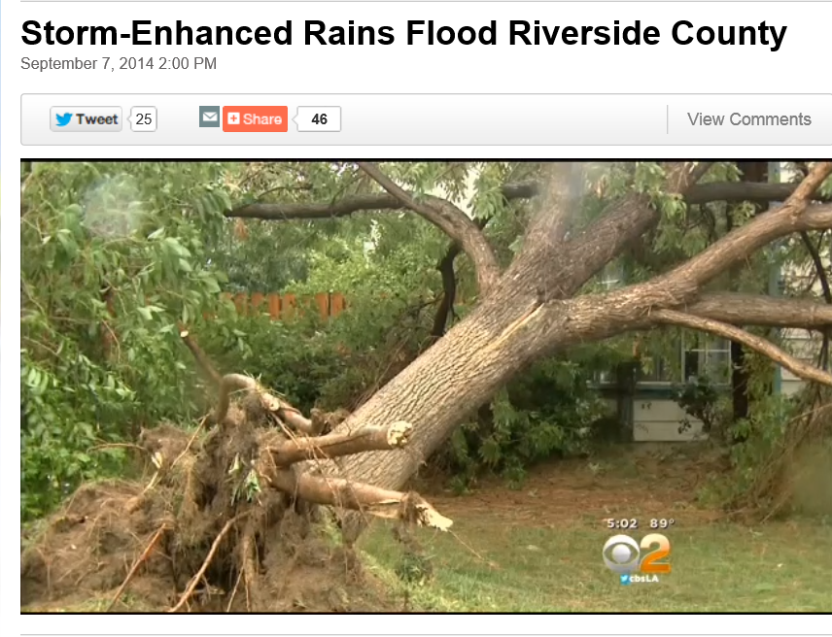
Before the Storm
Clean gutters and cut down weakened trees that could damage your home.
Take care of grading or drainage needs on your property.
Check for loose roof tiles or shingles, fix roof leaks.
Store outdoor furniture and other objects that could be damaged by storms or thrown by winds.
Inspect retaining wall drain holes, surface and subsurface drains and yard drains for signs of obstruction or malfunction.
Establish native plants or place other ground cover on bare ground, slopes or freshly graded areas.
Notes:
This slide provides a checklist of things that you can do to inspect your property and prepare it for the wet season. A copy of the presentation is available in the back, and it contains this checklist.

Slide 18
Before the Storm –
Clear private drainages of obstructions
Most flood-prone drainage areas of low-lying property will have a natural water courses that must remain clear of obstruction.
Failure to maintain drainage areas can contribute to flooding of adjacent property.
Riverside County Unincorporated Community Drainage Task Force
Homeowner guidance for watercourse cleaning and slope stabilization;
Guidance for removal of structures/walls/debris blocking drainage;
Assistance with regulatory permitting; and
Drainage junk/debris removal support.
(951) 955-2004
Notes:
Keeping drainages clear is critical to effectively managing floods. The County has formed a task force to look for properties in our unincorporated communities that may cause or contribute to flooding due to blocked or overgrown drainage courses.
The Task Force is also available to help residents with advice and guidance with regard to how to properly clear and maintain those drainages.

Slide 19
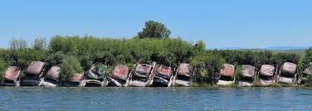
Before the Storm –Stream Stabilization
Contact the County to determine if local, state or federal permits are required before doing any of the following in a wash, stream, lake or river (whether or not water is flowing):
Remove soil, rock or plant material from a streambed or bank;
Place any waste, material or structures within or on the bank– even if to armor or stabilize;
Divert, obstruct or otherwise modify the bed, channel or bank; or
Dispose or deposit debris, liquid, solid waste or soil.
Failure to do so may result in violations of local, state and/or federal law – Call (951) 955-2004 for assistance from the County (in unincorporated areas).
Notes:
This is particularly important because some drainages are regulated by state and federal environmental law, if property owners try to grade or fill those drainages, they can violate those laws. This task force can help keep property owners on the right side of the law.

Slide 20
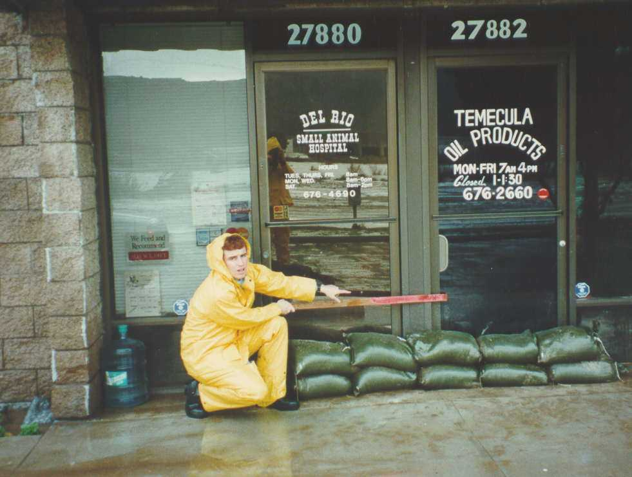
Before the Storm – Sand Bagging
Stage and store sand and sandbags before the storm.
You can obtain sand and sandbags from the local hardware store.
For information regarding how to fill a sandbag: http://www.rcflood.org/FloodSafety.aspx
Sandbags will last as long as they don’t have a hole. If the bags are reusable, residents should keep them for the next major rainstorm. To discard, distribute sand in a flower bed or over a lawn, and then throw away the empty bags.
It is illegal to dump sand in a stream, in the gutter, or in the storm drain system.
Notes:
If you think you will have flooding problems. Buy sand bags in advance. Also, keep in mind that the primary purpose of sand bagging your residence is to protect your home – to prevent water from seeping in your front door or garage door.
In an emergency, the fire department will have limited supplies of sand bags to provide residents.

Slide 21

Family Preparedness
COUNTY OF RIVERSIDE
EMERGENCY MANAGEMENT DEPARTMENT
(951) 955-4700
WWW.RIVCOREADY.ORG
Notes:
I would now like to introduce xxx from EMD

Slide 22
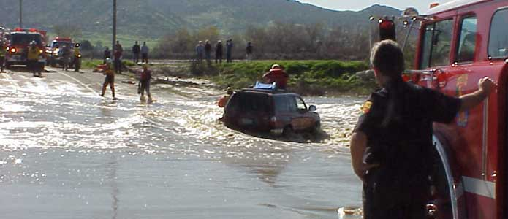
During the Storm
Avoid unnecessary trips, only travel in emergency situations.
DO NOT “sightsee” in flooded areas.
DO NOT attempt to go around barricades.
DO NOT try to cross low water crossings that have flowing water.
  Two feet of flowing water can move a 2,000 pound car.
  6 inches of water can sweep you off your feet.

Slide 23
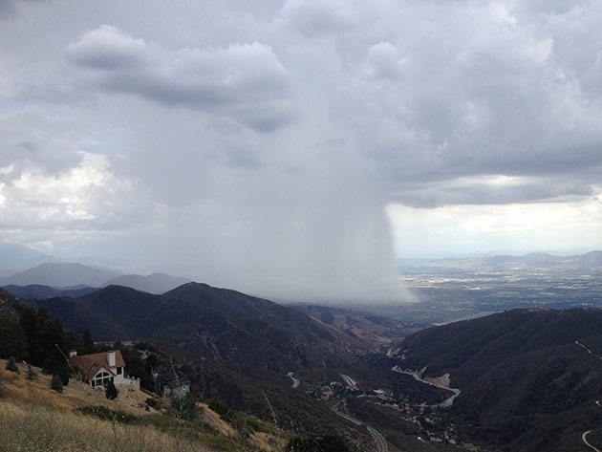
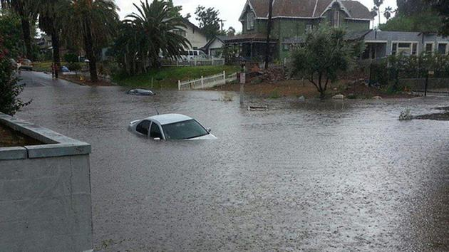
During the Storm
In an emergency dial “911”
Clogged channels – call 951.955.1230
Clogged inlets, road culverts, roadside ditches – call 951.955.1230

Slide 24

Make a Kit
Start by considering what hazards you are vulnerable to: flooding, power outages, earthquakes, etc.
Consider what, if any, equipment, medication, phone numbers or supplies you will need to sustain your needs and or maintain basic comfortability. Here are a few ideas; for more ideas visit: www.rivcoready.org
  Assistive devices & medications
  Food (canned or Meals Ready to Eat (MRE)
  Water (1 gal/person/day minimum *don’t forget to add extra for pets and hand washing*
  Pet supplies (leashes, food dish, food, etc.)
  Contact lists
  Out of state contact(s)
  Cell phone charger (electric, solar, etc.)
  Flashlight & batteries
  Generator if possible
  Waterproof matches
  Light and warm clothing, rain poncho, hat, dry socks, etc.
  Non-latex gloves
  Hand sanitizer (evaporates over time, replace annually)
Prepare for a minimum of three days (seven days is preferred)
Preparing a kit doesn't have to cost a lot of money!
  You probably already have a lot of the things you will need
  Putting them together so you can quickly find everything when disaster strikes will give you piece of mind and help you cope with the disaster
  Utilize local stores where nothing is over $1.00
Don’t forget to plan for your pets!

Slide 25

Have a Plan
Developing a plan doesn’t have to be overwhelming!
Consider some basic points when creating a plan
  What are the family dynamics -do you have kids, elderly, medically fragile people in the home to consider?
  Do you travel a long distance from work, home or school, each day?
  Who will look after your home if you are away?
Write down meeting place locations (primary, secondary)
Identify travel arrangement plans (from work, to pick up kids, etc.)
Store a list of important phone numbers in your kit – including your insurance provider*
*most homeowners insurance policies do not include flood or earthquake coverage – call and ask!
Keep a copy of your plan with your kit
Make sure everyone who needs to know about your plan, does!
Practice the plan from time to time to keep it fresh in your mind; make updates as necessary
Know where to seek information about the disaster (i.e. local radio stations, websites, etc.)

Slide 26

Stay Informed
Knowing where to get information before, during and after a disaster can have a direct effect on your ability to respond and recover!
Knowing your local radio and news stations can help you stay informed!
Here are some other information resources you should become familiar with:
During the disaster:
www.rvcfire.org
www.riversidesheriff.org
www.dot.ca.gov
www.noaa.gov
Before the disaster:
www.rivcoready.org
www.rcflood.org
www.rvcfire.org
www.redcross.org
www.caloes.ca.gov
www.fema.gov
www.noaa.gov (weather)
After the disaster:
www.rivcoready.org
www.rcflood.org
www.connectriverside.org
www.redcross.org
www.caloes.ca.gov
www.fema.gov

Slide 27
QUESTIONS / COMMENTS

