Slide 1
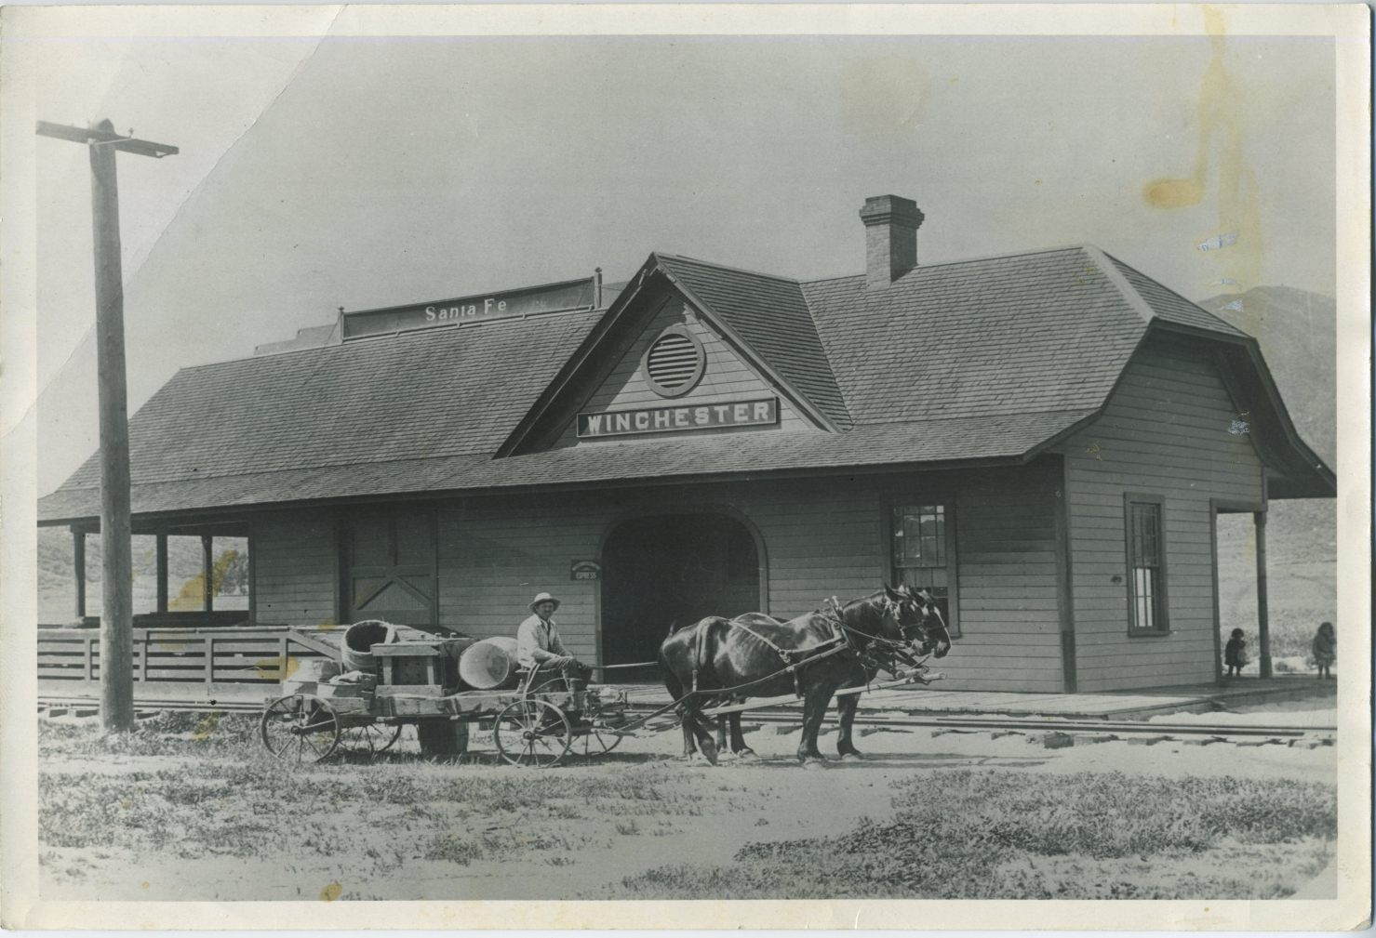
Land Use Study for the
Community of Winchester
May 21, 2012

Slide 2
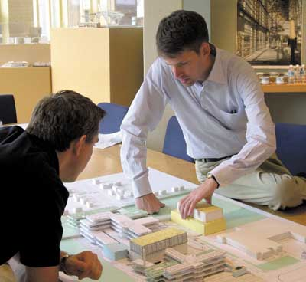
WELCOME
Overview of the Land Use Study
Downtown Core

Slide 3
Purpose of Downtown Core
  Identify Core Area Boundaries
  Prevent auto oriented build out patterns
  Retain historical grid street pattern
  Ensure downtown is developed to create a walkable, livable, vibrant and human scale environment
  Avoid inappropriate development patterns that conflict with a pedestrian orientation
  Create a clear sense of identity and place

Slide 4
Winchester Area Plan Policies
HVWAP 3.2 Recognize the community desire for future development projects within the Winchester Policy Area to reflect a western design theme.
LU 3.1 e) Re-plan existing urban cores and specific plans for higher density, compact development as appropriate to achieve the RCIP vision.
LU 3.1 a) Accommodate communities that provide a balanced mix of land uses, including employment recreation, shopping, and housing.
LU 4.1 t) Create a human-scale ground floor environment that includes public open areas that separate the pedestrian space from auto traffic or where mixed, it does so with special regard to pedestrian safety.

Slide 5
Winchester Area Plan Policies (cont.)
LU 10.1 Provide sufficient commercial and industrial development opportunities in order to increase local employment levels and thereby minimize long-distance commuting.
LU 22.5 Integrate a continuous network of parks, plazas, public squares, bicycle trails, transit systems, and pedestrian paths to provide both connections within each community and linkages with surrounding features and communities.
LU 10.4 Provide options to the automobile in communities, such as transit, bicycle and pedestrian trails, to help improve air quality.
LU 20.3 Require that adequate and available circulation facilities, water resources, sewer facilities, and/or septic capacity exist to meet the demands of the proposed land use.

Slide 6
Downtown Core
Identify Boundaries of the Downtown Core
General Plan recommends a Western Design Theme
Identify Desirable Community Character
What will make the Downtown unique to the community of Winchester?

Slide 7
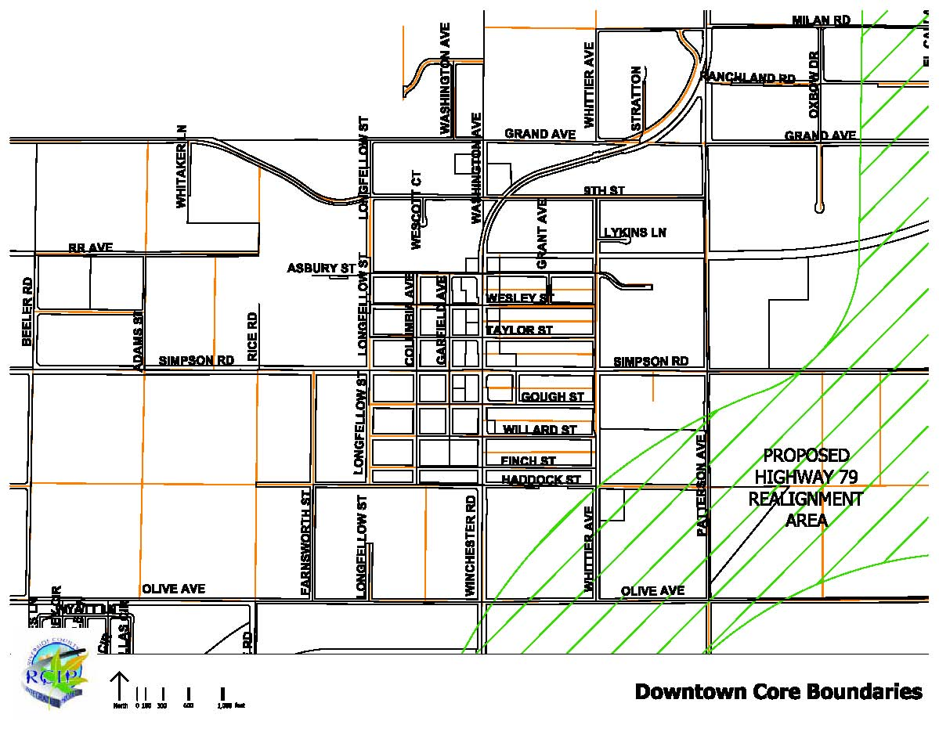

Slide 8
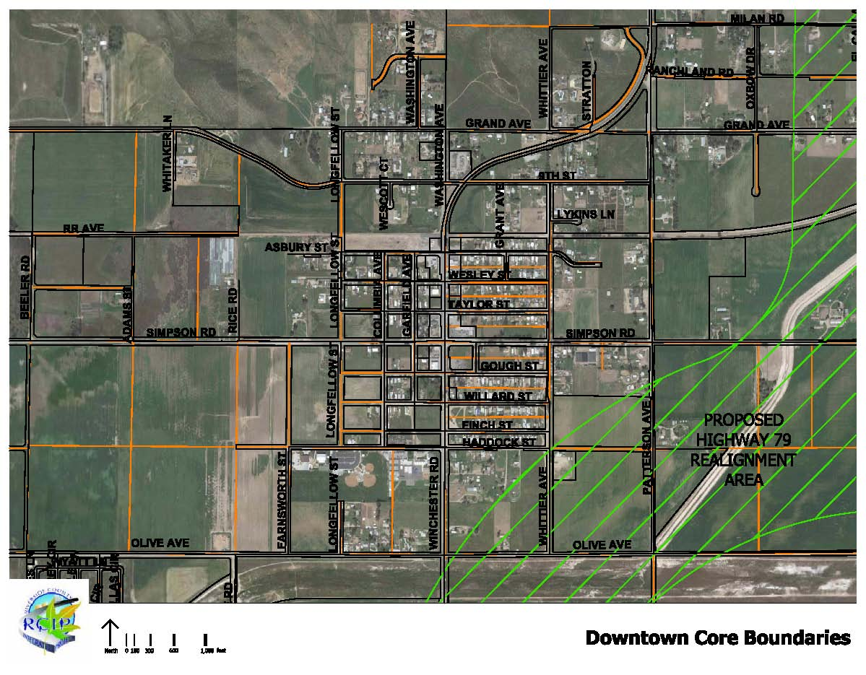

Slide 9
Pedestrian Oriented Development
Appropriate Land Uses
Mixed Use Development—Retail on first floor and office/residential above
Transit Oriented Development (TOD)
Transit Station in the Downtown

Slide 10
Pedestrian Oriented Development (cont.)
Small Scale Buildings with pedestrian orientation
Architecture and entries facing the street
No big box uses in the Downtown Core
Areas for public gathering spaces-cultural events/festivals/farmer’s market and concerts

Slide 11
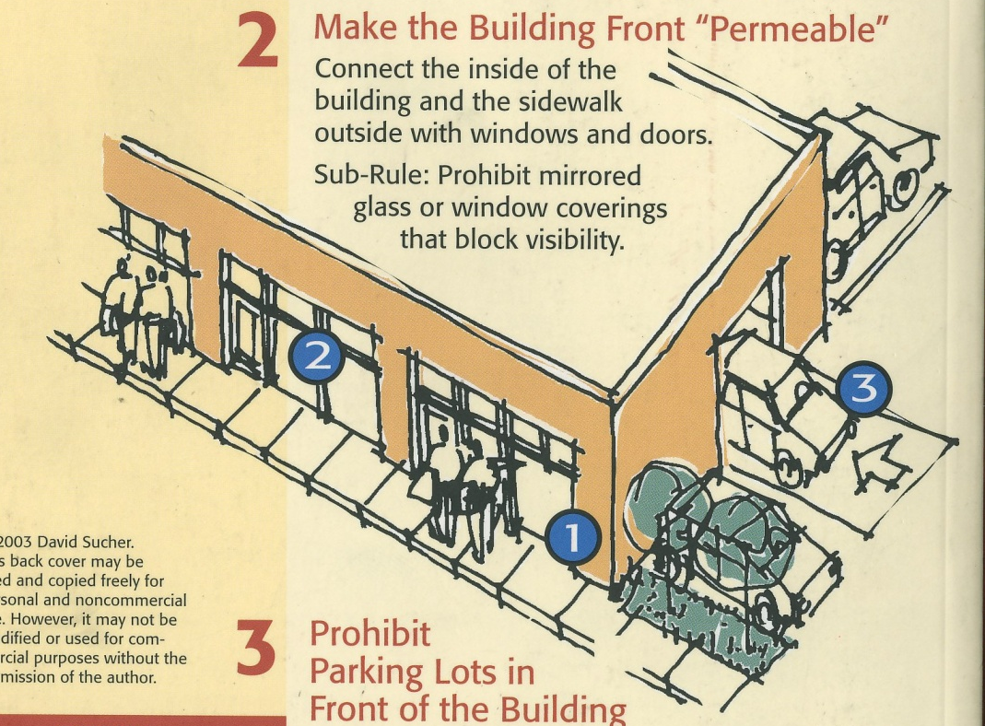
Design Guidelines
Basic Principles of Urban Streetscape
Build to the sidewalk (except open space/patios)
Make the building front “permeable”; no blank walls, entries and windows connect to sidewalk
Prohibit parking lots in front of the buildings

Slide 12
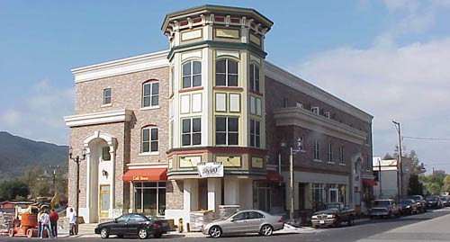
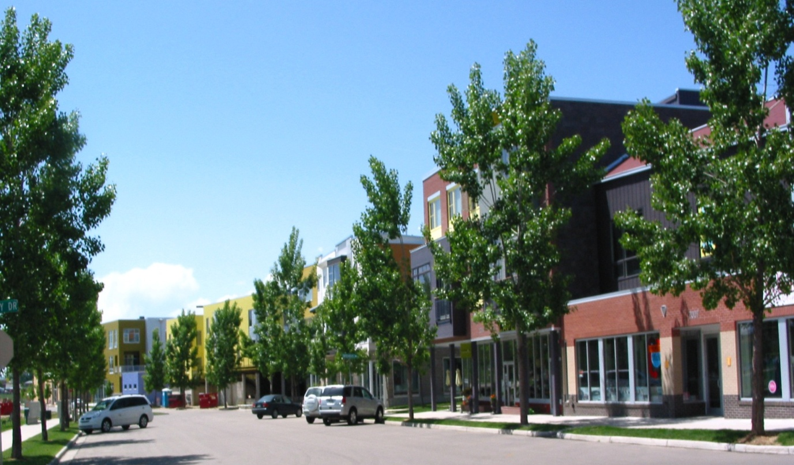
Mixed Use Development

Slide 13
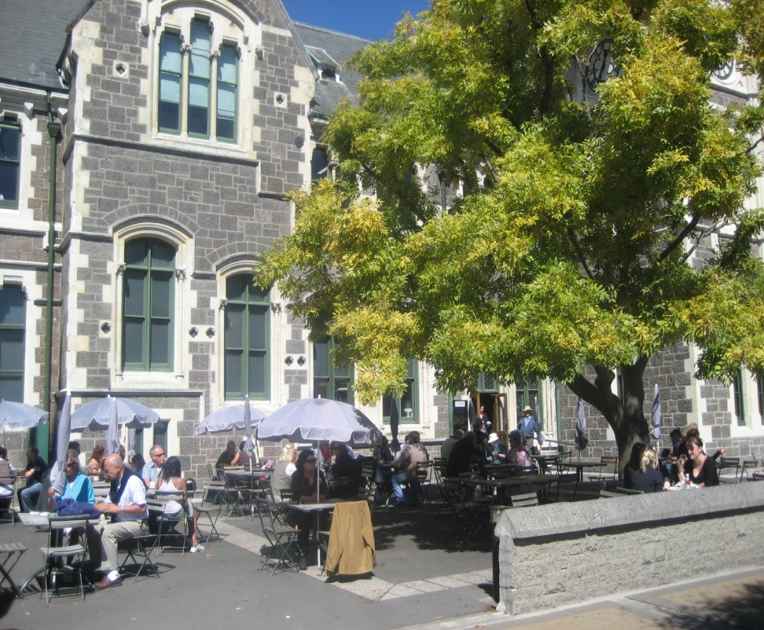
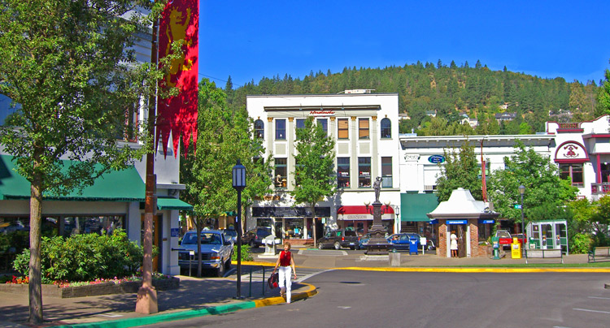
Mixed Use Development (cont.)

Slide 14
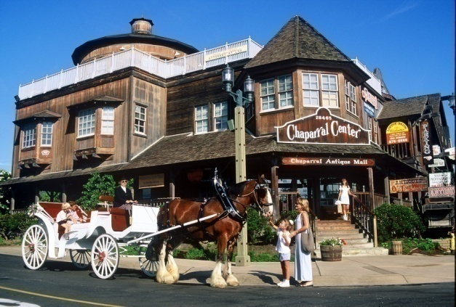
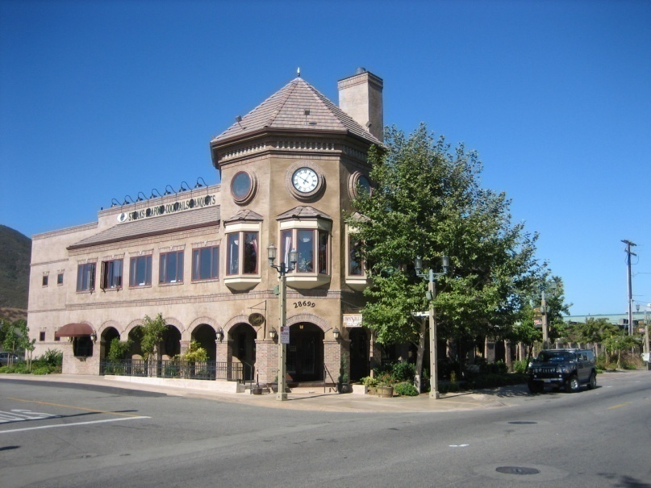
Architectural Styles

Slide 15
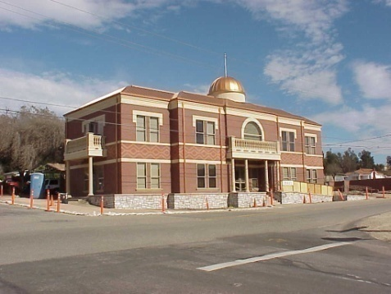
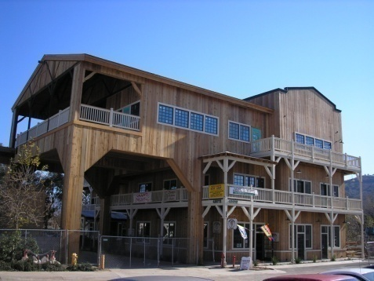

Slide 16
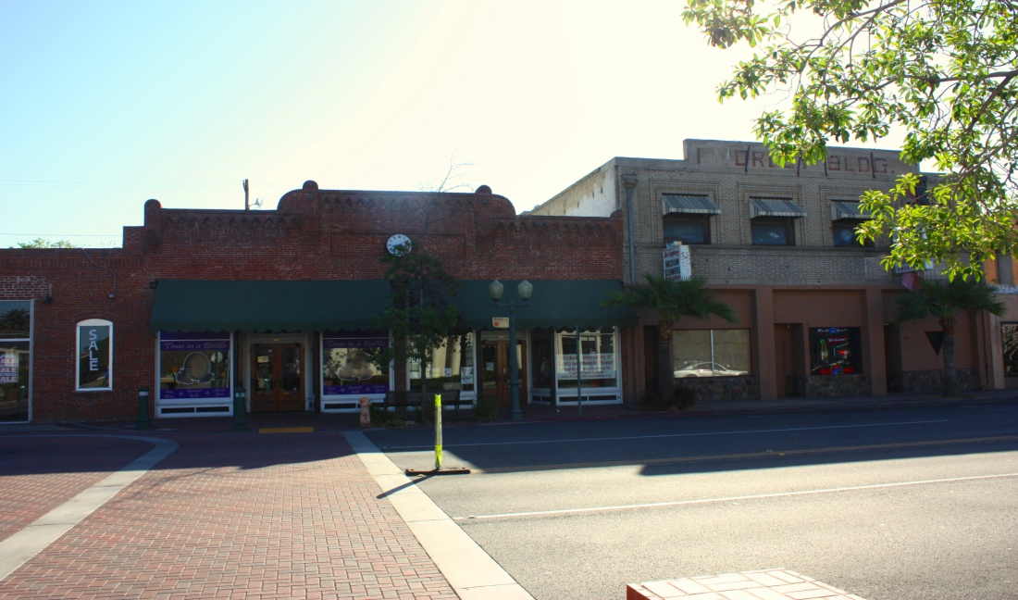
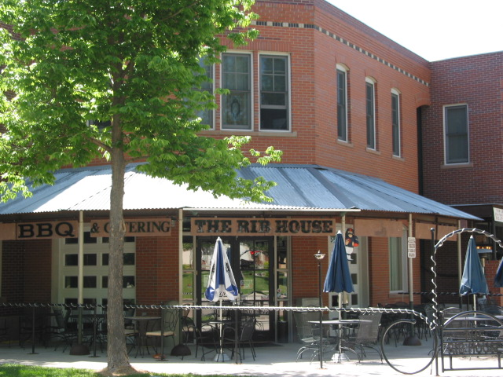
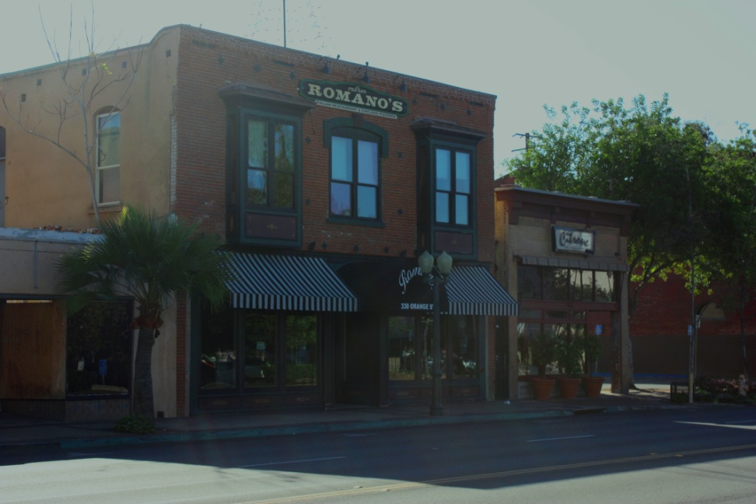

Slide 17
Construction Patterns
Prohibit buildings that do not contribute to a vibrant and lively downtown
Doors and Window connect to sidewalk—no blank walls
Build side property lines when there are alleys
Ensure sufficient infrastructure to support development (streets, sidewalks, curb/gutter, storm drain)

Slide 18
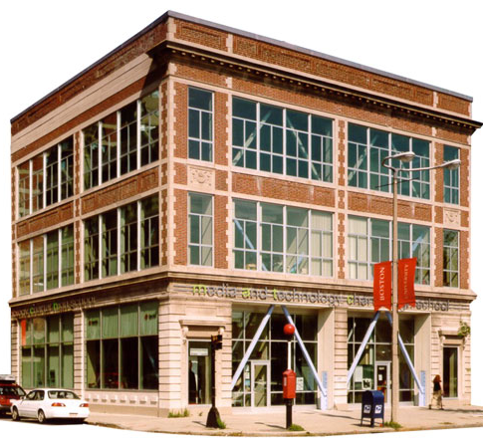
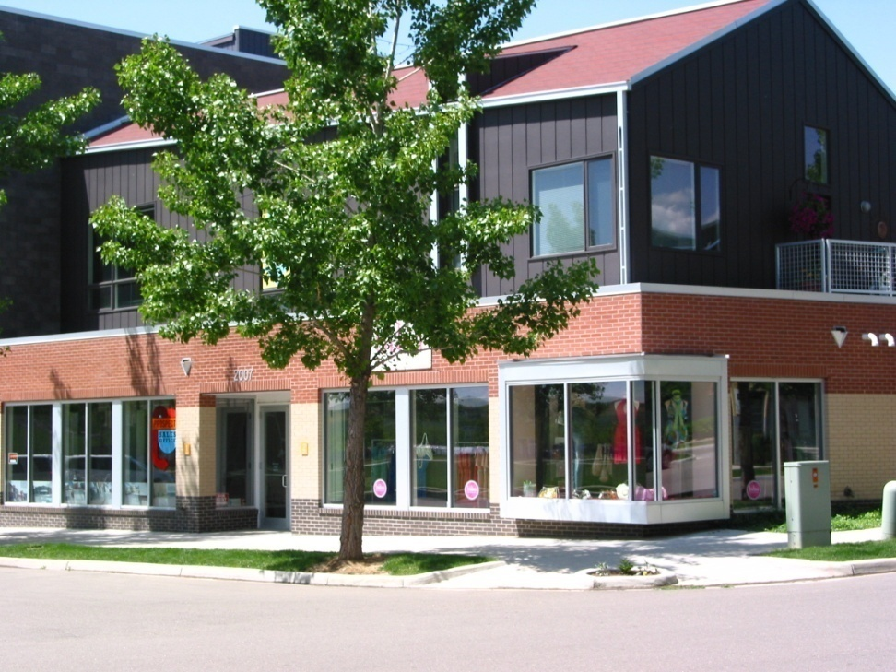
Examples of Mixed-Use Design

Slide 19
Pedestrian Streetscape
Wide sidewalks with landscaping, street furniture, and public art
Complete Street Design: pedestrian, bike, transit and automobile
Develop a consistent streetscape design theme that is pedestrian oriented
Element protection such as shade covers, awnings, colonnades or street trees.

Slide 20
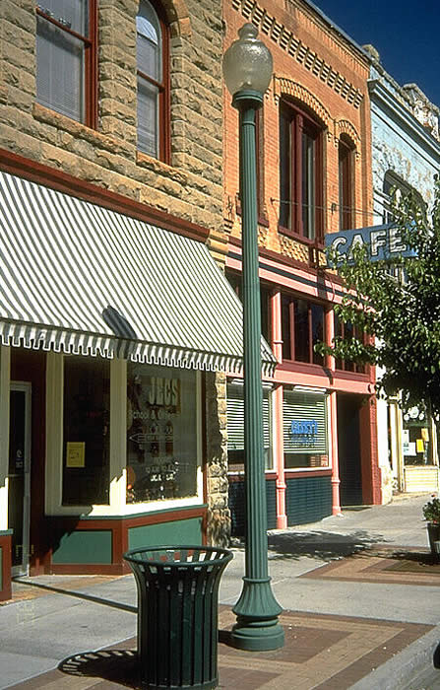
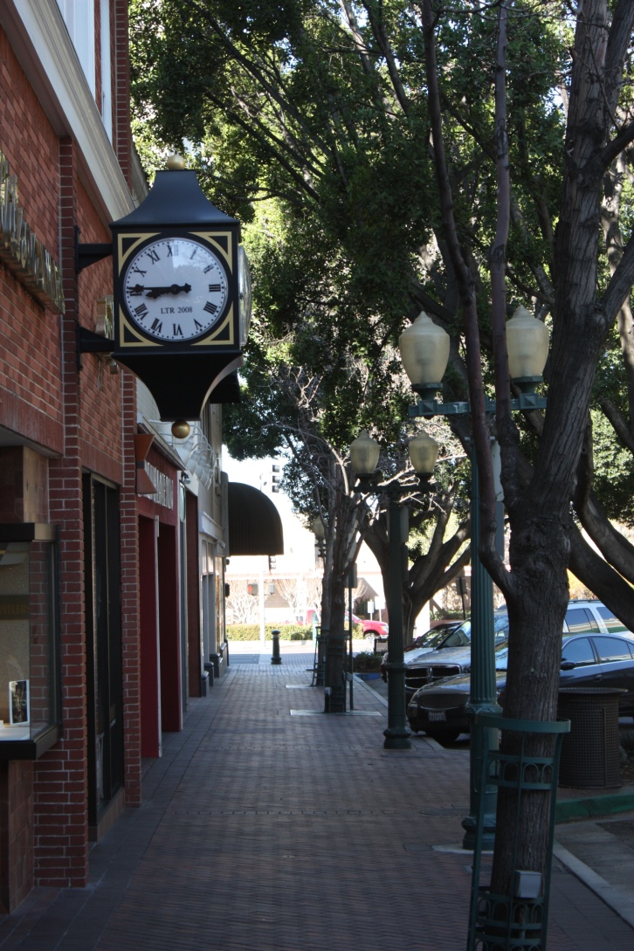
Pedestrian Streetscapes

Slide 21
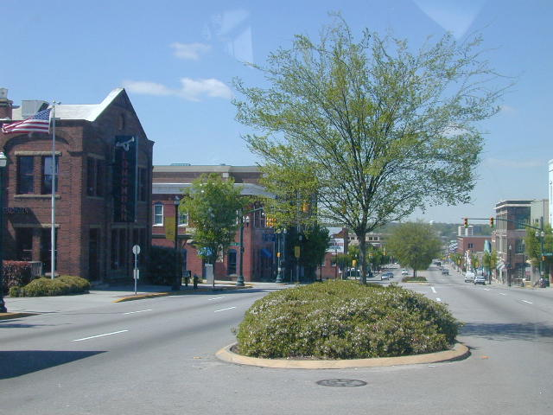
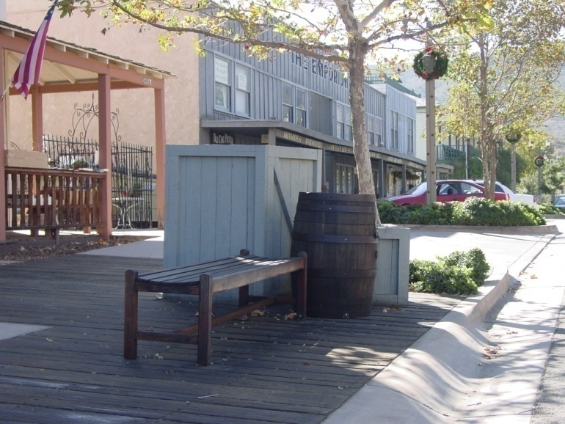
Pedestrian Streetscapes (cont.)

Slide 22
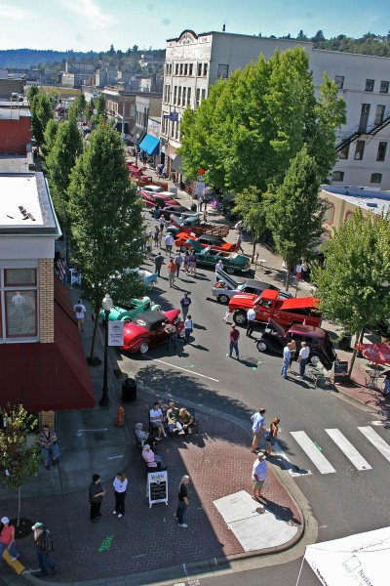
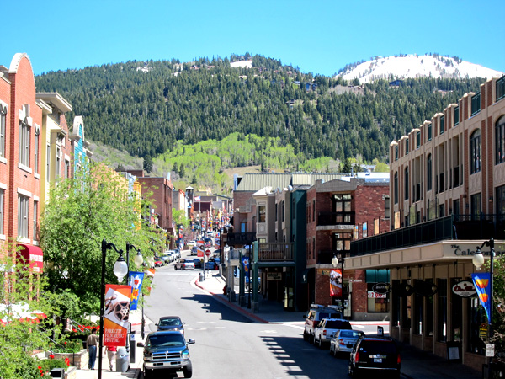
Pedestrian Streetscapes (cont.)

Slide 23
Monumentation
Identify key entry points that create a sense of arrival
Develop entry monumentation that reflects design theme of Downtown
Encourage buildings that enclose and frame corners of major intersections to define and identify street

Slide 24
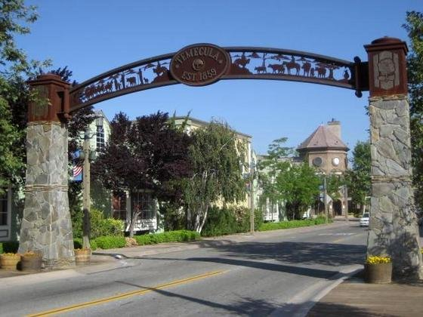
Entry Monumentation

Slide 25
Other Appropriate Uses in Downtown Core
Civic, libraries, schools, or cultural uses
Universities, Senior Centers, Theaters, or Museums
Plazas, open spaces, courts
Pedestrian connectivity throughout Downtown and surrounding uses

Slide 26
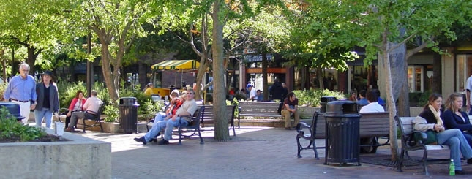
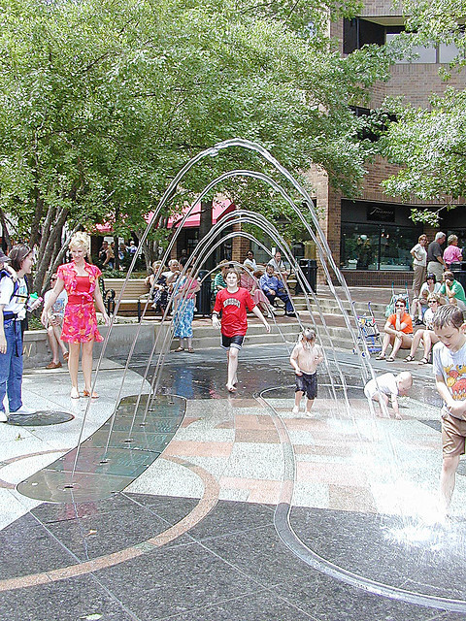
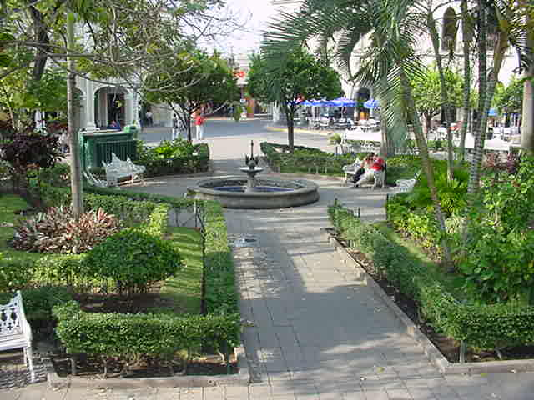
Community Open Space

Slide 27
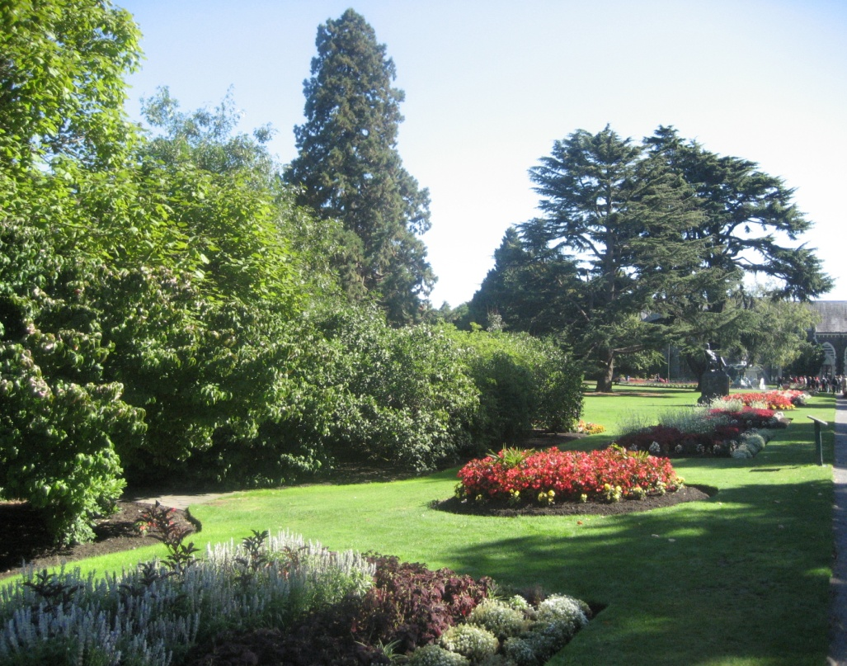
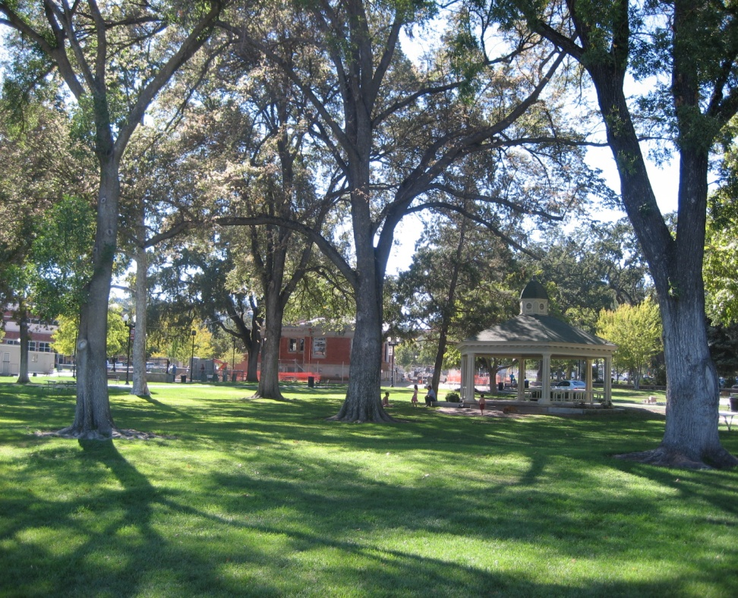
Passive Open Space

Slide 28
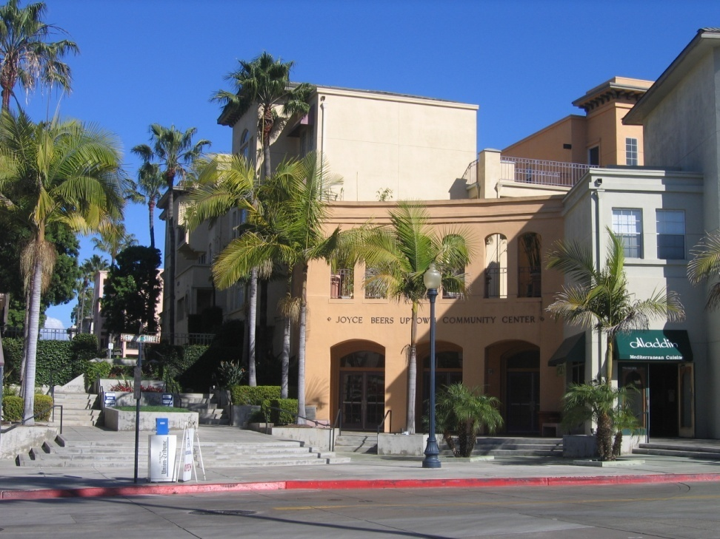
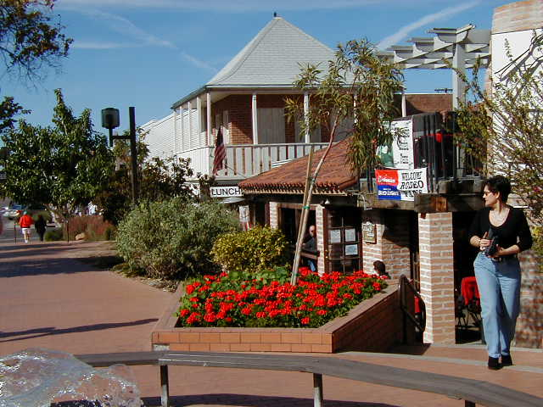
Civic/Public Uses

Slide 29
Next Steps:
Consultant will provide additional Goals, Policies and Objectives that support the concept of a livable, pedestrian oriented Downtown
Draft set of Goals, Policies and Objectives will be posted on the Winchester Municipal Advisory Council (WMAC) for review and comment
Next Community Workshop: June 11, 2012

